Slide 1
Confronting Participation and Engagement Issues in Social Welfare Interventions
Kristen Slack, PhD
University of Wisconsin-Madison
April, 2017

Slide 2
Challenge
Encouraging families to participate and engage in social welfare services when they are not asking for or seeking support.

Slide 3
Participation and Engagement Definitions
“Participation refers to signs of client and program activity, such as enrollment, number and frequency of visits, and service completion” (Institute for Child and Family Well-Being, 2016).
“Engagement reflects the quality of client attitudes toward, emotional investment in, and behaviors related to their services and service providers” (Institute for Child and Family Well-Being, 2016).
Engagement is “the process* by which families and providers* develop and maintain a connection, while simultaneously demonstrating and communicating information, needs, attitudes, and values” (McGinty et al.,2003, p. 489, as published in Staudt, 2007).
*Emphasis added
Notes:
Discuss the behavioral vs. the attitudinal components of engagement, and the role of the interactional aspects of the engagement process. The attitudinal component can be likened to “buy-in”, but may also be comprised of factors like trust, quality of the relationship with providers, etc.

Slide 4
Availability
Awareness
Contact
Impact
Enrollment
Attendance
Completion
Interest
Intent to Enroll
Participation
Engagement
Voice of Service
Population
Access Continuum
Slack, K.S. (2017)
Notes:
Interest and Contact could happen simultaneously, or either could precede the other.

Slide 5
How do we think about non-participation?
TYPE OF NON-PARTICIPATION
REASONS FOR NON-PARTICIPATION
  Relevance and/or potency of marketing and outreach materials?
  Competing demands, logistical hurdles?
  Characteristics of individuals/families from intended service population?
  Initial interaction with program staff?
  Ongoing interactions with program staff or program site?
No outreach connection
Avoidant refusals: Ignoring letters and other outreach efforts.
Active refusals: “I don’t want or need this service”.
Passive refusals: “Sounds good, I’ll be there”, followed by a no-show
Reactive refusals: Initial attendance, followed by spotty or no further attendance.

Slide 6
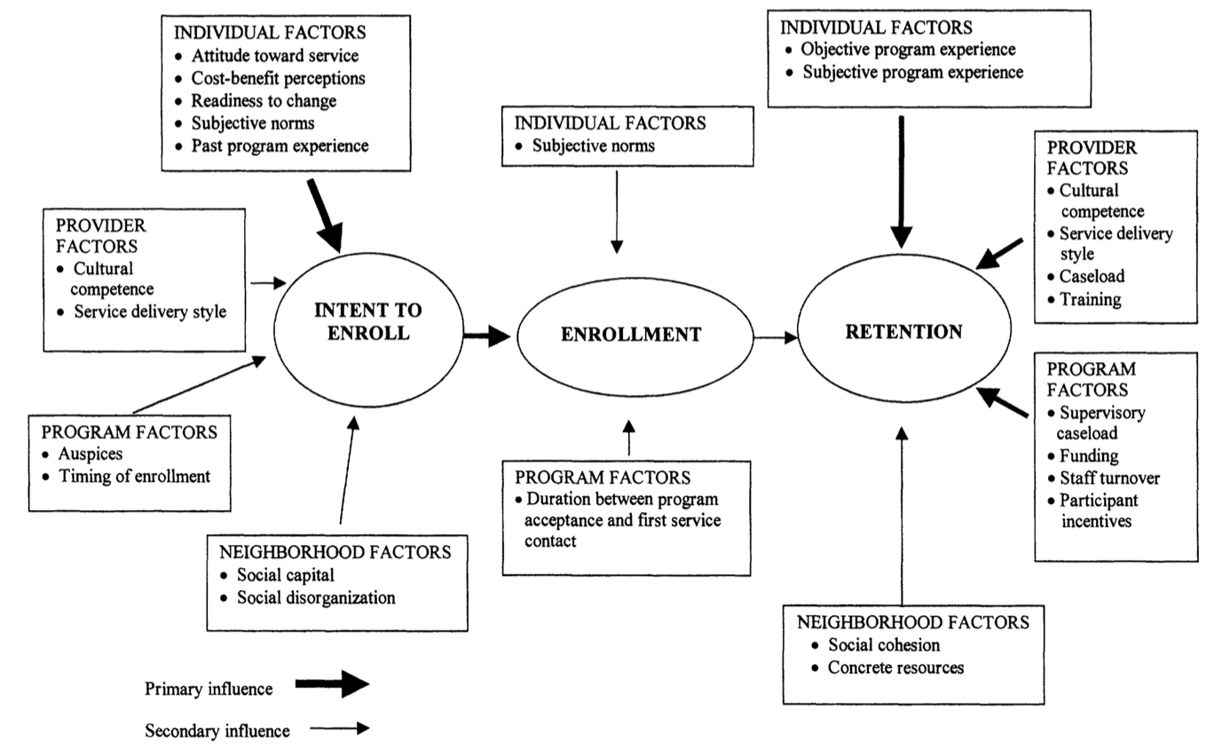
Integrated Theory of Participant Involvement
(McCurdy & Daro, 2001)

Slide 7
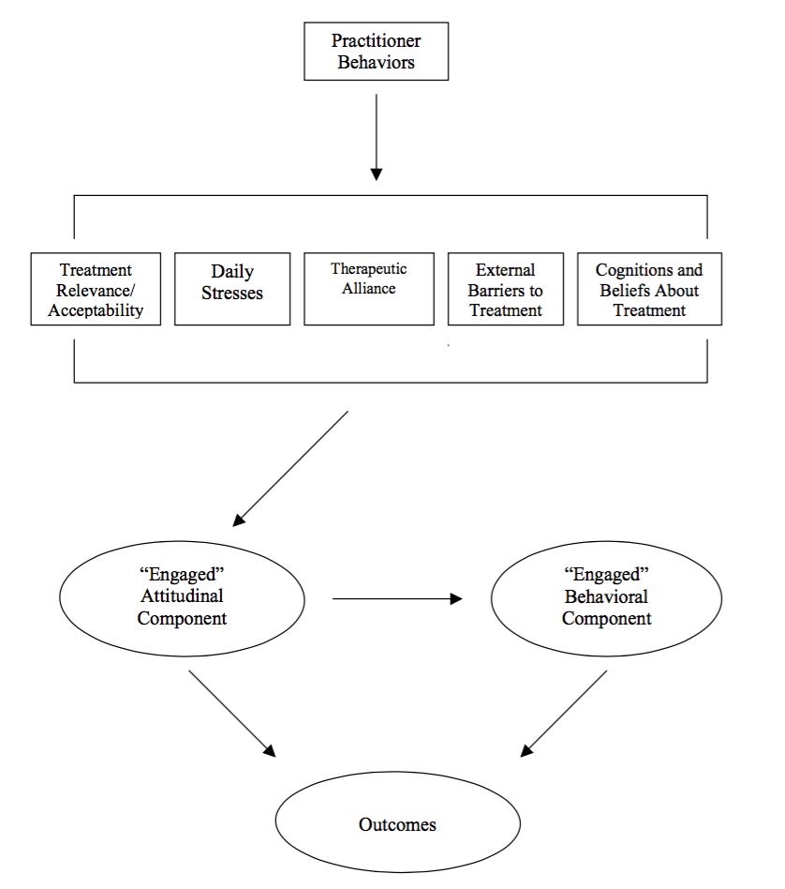
Engagement Framework (Staudt, 2007)

Slide 8
Select Research Findings on Prevention Services Participation and Engagement
Some research has shown that low-income status, racial or ethnic minority group status, and single parenthood are each associated with lower prevention service participation and engagement rates, but little research sheds light on why.
An evaluation of a Wisconsin home visiting program found that over half of those who did not enroll in services felt they didn’t need help or already had sufficient support (Institute for Child and Family Well-Being, 2016).
Use of monetary incentives to enhance program engagement has had mixed results: Some evidence that they enhance recruitment, but not ongoing participation or engagement (Dumas et al., 2010; Heinrichs, 2006; Rostad et al., 2017)

Slide 9
Practice Insights on Prevention Services Engagement
Hierarchy of needs
Motivation
Service Relevance
Other service options
Competing demands
Stigma
Cultural relevance
Logistical challenges
Sellevaag, Palmer, and Brown, 2012

Slide 10
Questions for Discussion
How do agency staff conduct outreach and disseminate information about an intervention to intended service populations?
How do staff ensure that program components are culturally sensitive and highly relevant to families?
How do staff move beyond disseminating information to motivating participation and engagement?
How do staff collect feedback on the intervention from participants?
How do staff learn why people choose not to participate?
How do staff determine whether an intervention works?

Slide 11
References
Dumas, J. E., Begle, A. M., French, B., & Pearl, A. (2010). Effects of monetary incentives on engagement in the PACE parenting program. Journal of Clinical Child & Adolescent Psychology, 39(3), 302–313.
Heinrichs, N. (2006). The effects of two different incentives on recruitment rates of families into a prevention program. Journal of Primary Prevention, 27(4), 345–365.
Institute for Child and Family Well-Being (2016). Issue Brief: Engaging Families in Home Visiting. https://uwm.edu/icfw/engaging/.
McCurdy, K. & Daro, D. (2001). Parent involvement in family support programs: An integrated theory. Family Relations, 50(2), 113-121.
McGinty, K. L., Diamond, J. M., Brown, M. B., & McCammon, S. L. (2003). Training child and adolescent psychiatrists and child mental health professionals for systems of care. In A. J. Pumariega & N. C. Winters (Eds.), The handbook of child and adolescent systems of care: The new community psychiatry (pp. 487–507). San Francisco, CA: Jossey-Bass.
Piper, K.A. (2016). Differential Response in Child Protection Services: A Comparison of Implementation and Child Safety Outcomes. (Doctoral Dissertation). Retrieved from ProQuest, (10010854).
Rostad, W.L., McGill Rogers, T. & Chaffin, M.J. (2017). The influence of concrete support on child welfare program engagement, progress, and recurrence. Children and Youth Services Review, 72, 26-33.
Sellevaag, M., Palmer, M., & Brown, A. (2012). Rules of Engagement: Participant Recruitment and Retention. Office of Adolescent Health, U.S. Department of Health and Human Services. https://www.hhs.gov/ash/oah/news/assets/rules_of_engagment_slides.pdf
Staudt, M. (2007). Treatment engagement with caregivers of at-risk children: Gaps in research and conceptualization. J of Child & Family Studies, 16, 183-196.

